Slide 1

DevOps Webinar
Akshiv Rajendran
Cloud DevOps Corporate Trainer ©

Slide 2
Intro to DevOps
DevOps is a set of practices that combines software development and IT operations to help organizations deliver applications at a higher velocity. Let's explore the world of DevOps!
In tech terms, DevOps uses things like automation, clever tools, and a culture of collaboration to make sure that the software gets developed, tested, and delivered in smaller, safer steps. This way, any problems can be caught and fixed early, making the software more stable and secure.
Ultimately, DevOps is about teamwork, communication, and using smart tools to make software development and operation smoother and more efficient.
Instead of working separately, DevOps helps these teams work together closely right from the start of a project until it goes live and even afterward. It's all about making the whole process smoother, faster, and more reliable.

Slide 3
SDLC (Software Development Life Cycle)
The Software Development Life Cycle (SDLC) is a step-by-step process that outlines how software is conceptualized, designed, developed, tested, deployed, and maintained. It's like a roadmap that guides the entire journey of creating software, from the initial idea to its retirement.
Phases of SDLC:
Planning
Analysis
Design
Development
Testing
Deployment
Maintenance

Slide 4
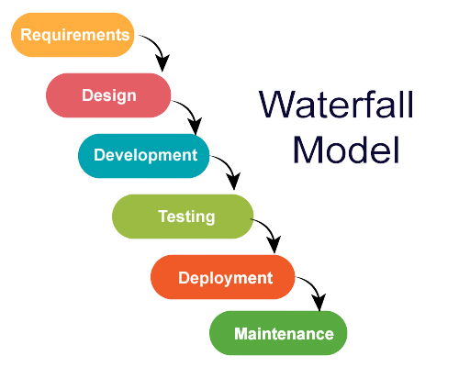
Models of SDLC
Waterfall Model:
This is a linear and sequential approach where each phase is completed before moving on to the next. It includes phases like Requirements, Design, Implementation, Testing, Deployment, and Maintenance. Changes are difficult once a phase is completed.

Slide 5
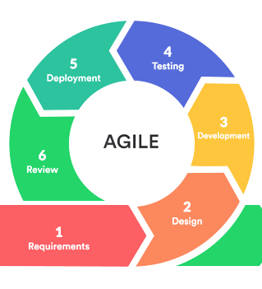
Agile Model:
Agile is iterative and flexible, focusing on collaboration, adaptability, and customer feedback. It breaks the development process into smaller cycles called "sprints" and emphasizes continuous improvement and flexibility to change requirements.

Slide 6
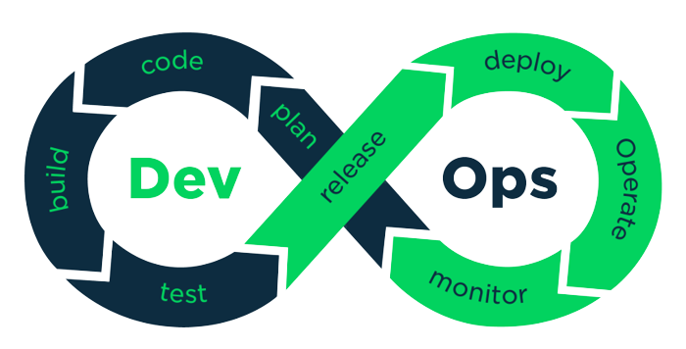
DevOps Model:
While not a traditional SDLC model, DevOps integrates development and operations to streamline the entire software delivery process, focusing on automation, collaboration, and continuous improvement.

Slide 7
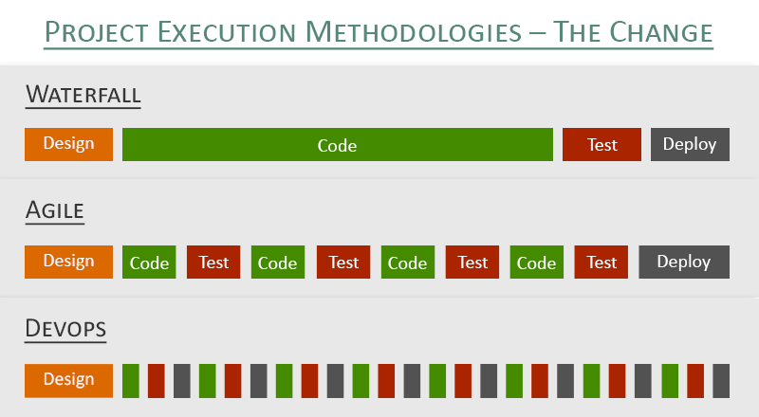
Difference between SDLC Models:

Slide 8
Why Companies are adopting DevOps Methodologies
Faster Time to Market:
DevOps practices emphasize automation and collaboration, allowing teams to deploy updates and new features more frequently. This rapid and continuous delivery helps businesses stay competitive by getting valuable improvements to users faster.
Enhanced Collaboration and Communication:
DevOps breaks down silos between development, operations, and other teams. By fostering a culture of collaboration and communication, it promotes shared responsibilities, leading to better decision-making and problem-solving.
Increased Stability and Reliability:
Continuous testing and integration in DevOps catch errors early in the development cycle. This results in more stable code and reduces the likelihood of major issues in production, ensuring a more reliable software product.
Scalability and Flexibility:
DevOps practices, such as infrastructure as code and automated deployment, enable teams to scale resources quickly and efficiently. This scalability ensures that software can handle increased loads and adapts well to changing user demands.
Continuous Feedback and Improvement:
DevOps emphasizes monitoring and gathering feedback from software in real-time. This data-driven approach helps teams identify areas for improvement, allowing for continuous enhancements to the software.
Cost Efficiency:
By automating repetitive tasks and streamlining processes, DevOps reduces manual effort and operational costs. It optimizes resource utilization and minimizes downtime, resulting in cost savings for organizations.
Competitive Advantage:
Businesses adopting DevOps often respond faster to market changes, customer needs, and technological advancements. This agility provides a competitive edge in delivering innovative solutions and adapting quickly to evolving market trends.
In today's fast-paced and dynamic software landscape, where customer expectations are high, and technology evolves rapidly, DevOps practices help organizations stay adaptable, efficient, and responsive to the ever-changing demands of users and the market.

Slide 9
Overview of top DevOps tools and their purpose
Continuous Integration/Continuous Deployment (CI/CD):
Jenkins: An open-source automation server used for building, testing, and deploying software. It integrates with various version control systems and supports multiple plugins.
GitLab CI/CD: Integrated into the GitLab platform, it offers a complete DevOps lifecycle tool, including version control, CI/CD pipelines, and container registry.
Configuration Management:
Ansible: An automation tool that focuses on configuration management, application deployment, and task automation. It uses simple YAML-based syntax and does not require agents on remote systems.
Chef: A powerful automation platform that uses a declarative approach to infrastructure as code. It helps manage complex infrastructures and deployments.
Puppet: Another configuration management tool used for automating infrastructure provisioning, configuration, and management across various environments.
Infrastructure as Code (IaC):
Terraform: A tool for building, changing, and versioning infrastructure efficiently. It uses a declarative configuration language and supports multiple cloud providers.
AWS CloudFormation: Amazon's service for defining and provisioning AWS infrastructure as code. It enables the creation and management of AWS resources using templates.
Azure Resource Manager (ARM) Templates: Azure's tool for deploying and managing Azure resources using declarative JSON templates.
Containerization and Orchestration:
Docker: A popular platform for developing, shipping, and running applications in containers, ensuring consistency across different environments.
Kubernetes: An open-source container orchestration platform that automates the deployment, scaling, and management of containerized applications.
Monitoring and Logging:
Prometheus: An open-source monitoring and alerting toolkit that collects metrics from configured targets, allowing for visualization, alerting, and analysis.
Grafana: A visualization tool used with time-series databases like Prometheus to create and share dashboards and graphs for monitoring and analysis.
ELK Stack (Elasticsearch, Logstash, Kibana): A combination of open-source tools used for centralized logging, log processing, storage, and visualization.

Slide 10
Current state of DevOps market
Growing Adoption Across Industries:
Enterprises Embracing DevOps: Companies across sectors like finance, healthcare, e-commerce, and more were integrating DevOps methodologies to accelerate software delivery and improve operational efficiency.
SMBs Adopting DevOps: Small and medium-sized businesses were also recognizing the value of DevOps in streamlining development and operations.
Increased Emphasis on Automation:
Shift Toward Automation: Automation was at the core of DevOps, with a strong focus on tools and practices that automated various stages of the software development lifecycle (SDLC).
Rise of Cloud-Native Technologies:
Cloud-Based DevOps: The adoption of cloud-native technologies, including containers (e.g., Docker) and orchestration tools (e.g., Kubernetes), played a significant role in enabling scalable and flexible infrastructure management.
DevSecOps and Security Integration:
Security Integration: DevSecOps gained traction, emphasizing the integration of security practices early in the software development process to address vulnerabilities proactively.
Tools and Ecosystem Expansion:
Diverse Tool Ecosystem: A wide range of DevOps tools and platforms continued to evolve, offering solutions for CI/CD, configuration management, containerization, monitoring, and more.
Consolidation and Integration: Some consolidation and integration were observed among DevOps tool providers, aiming to offer more comprehensive solutions.
Cultural Shift and Skill Development:
Cultural Transformation: Beyond tools, companies focused on fostering a DevOps culture, emphasizing collaboration, communication, and shared responsibilities across teams.
Skill Development: There was an increasing demand for professionals skilled in DevOps practices, automation, cloud technologies, and related toolsets.
Remote Work and DevOps Practices:
Adapting to Remote Work: The COVID-19 pandemic accelerated the adoption of remote-friendly DevOps practices, emphasizing the need for distributed collaboration and remote tool access.
Continuous Evolution and Innovation:
Ongoing Evolution: DevOps practices and tools continued to evolve, driven by the need for greater speed, reliability, and efficiency in software development and delivery.
The DevOps market was dynamic and evolving, with companies continuously exploring new tools, methodologies, and best practices to improve software delivery, operational efficiency, and overall business agility. This market trend is likely to persist as organizations seek to innovate and stay competitive in their respective industries.

Slide 11
Benefits of learning DevOps for career growth
High Demand for DevOps Professionals:
Increased Industry Adoption: Many companies across sectors are embracing DevOps practices, leading to a high demand for professionals with DevOps skills.
Skill Shortage: There's a shortage of skilled DevOps practitioners, making it a lucrative field for career growth.
Diverse Career Opportunities:
Versatility: DevOps skills are applicable across various roles, including DevOps Engineer, Automation Architect, Release Manager, Cloud Engineer, and more.
Cross-functional Roles: DevOps professionals often work collaboratively across development, operations, and other departments, enhancing their exposure and career options.
Competitive Salaries:
High Earning Potential: DevOps roles often command competitive salaries due to the specialized skills and the critical role they play in streamlining processes and delivering value.
Continuous Learning and Innovation:
Constant Evolution: DevOps is a dynamic field that evolves with new tools, methodologies, and technologies. Continuous learning is inherent in DevOps, ensuring ongoing skill development.
In-Demand Skills:
Technical Proficiency: Learning DevOps involves acquiring skills in automation, cloud technologies, CI/CD pipelines, containerization, and infrastructure as code, which are in high demand.
Alignment with Industry Trends: DevOps aligns with industry shifts toward agile methodologies, cloud adoption, and rapid software development cycles.
Career Advancement Opportunities:
Leadership Roles: Proficiency in DevOps can lead to managerial or leadership positions overseeing teams and strategic planning for software development and operations.
Entrepreneurial Pursuits: DevOps skills are valuable for those considering entrepreneurial ventures, as they enable efficient and scalable product development and deployment.
Contribution to Business Success:
Impact on Business: DevOps professionals contribute directly to the success of the organization by improving software delivery, operational efficiency, and overall business agility.
Flexibility and Remote Work Opportunities:
Remote-Friendly Roles: DevOps roles often allow for remote work options due to the nature of collaboration, tooling, and automation involved.

Slide 12
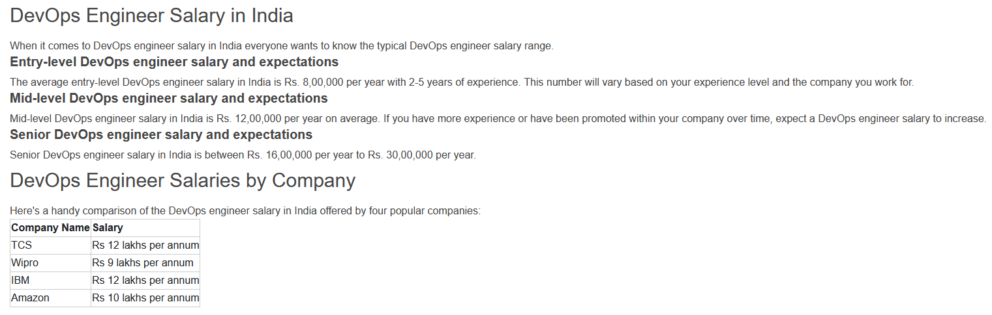

Market Standards

